Slide 1
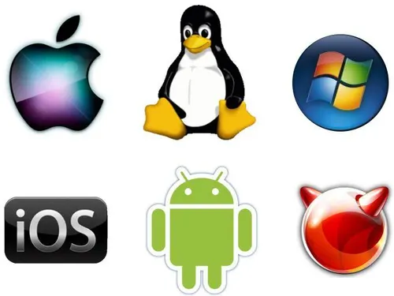
Introduction to Operating System
Overview, History, Types, and Installation via VirtualBox
Notes:
"In this chapter, we’ll explore what an Operating System is, its history, the different types of OS, and how we can install one using VirtualBox. This will help us understand the foundation of every computing system."

Slide 2
Learning Objectives
Define what an operating system is and explain its role in computing.
Describe the key functions and responsibilities of an OS.
Trace the historical evolution of operating systems from batch systems to modern cloud-based OS.
Identify and differentiate between various types of operating systems.
List common examples of OS used in desktops, servers, and mobile devices.
Demonstrate the basic steps of installing an operating system

Slide 3
What is an Operating System?
The OS is system software that acts as an interface between users and computer hardware.
It manages hardware, software resources, and provides services for application programs.
Notes:
n operating system is the core software that makes your computer usable. Without it, you wouldn't be able to run programs, use files, or interact with hardware. Think of it as a bridge between you and the machine

Slide 4
Key Functions of an OS
• Process Management
• Memory Management
• File System Management
• Device Management
• Security and User Interface
Notes:
The OS handles everything behind the scenes. It manages which program runs and when (Process Management), keeps track of memory usage, handles files, and manages devices like printers or keyboards. It also controls access to the system for security.

Slide 5
History and Evolution of OS
1950s
Batch processing systems
1960s
Multiprogramming & Time-sharing
1970s
UNIX systems
1980s–90s
GUI-based OS (Windows, macOS)
2000s
+: Mobile OS (Android, iOS) and Cloud OS
Notes:
Operating Systems have evolved from simple batch systems in the 1950s to complex, graphical, and mobile OS today. Each era solved a different problem—first automation, then multitasking, then user-friendliness, and now mobility and the cloud.

Slide 6
Types of Operating Systems
Microsoft Windows
MacOs
Linux
Notes:
"Linux isn’t just one operating system — it's a whole family of systems called 'distributions' or 'distros'. This is possible because Linux is open-source, meaning anyone can take the source code and make their own version. For example, Kali Linux is made for cybersecurity tools and penetration testing, while Ubuntu is made for everyday users and education. We're using Ubuntu because it’s stable, beginner-friendly, and commonly used for scripting, programming, and running web servers."
Linux is open-source — anyone can modify and distribute it.
This freedom leads to different versions or "distributions" (distros).
Examples:
Kali Linux – for cybersecurity and ethical hacking
Ubuntu – general use, servers, and education
Debian – very stable, base for Ubuntu
CentOS/Red Hat – for enterprise servers
Arch Linux – for advanced users who want full control

Slide 7


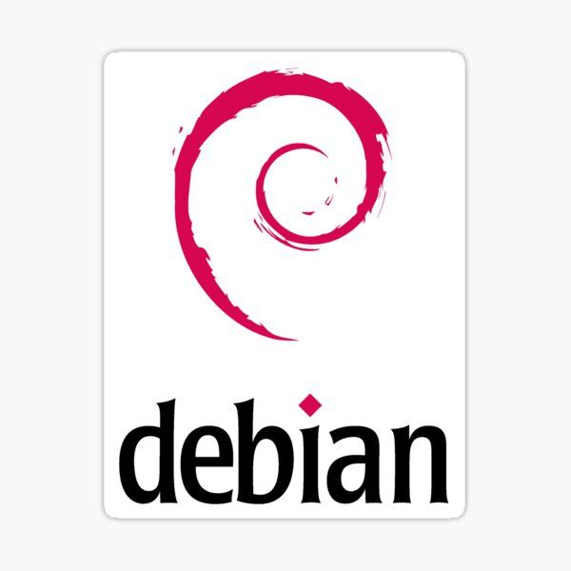

Kali Linux
Notes:
There isn’t one type of OS that fits all. For example, batch OS is used for jobs that require no user interaction, while real-time OS is used in devices like medical machines or robotics. Each type of OS is tailored for specific environment
Linux is open-source — anyone can modify and distribute it.
This freedom leads to different versions or "distributions" (distros).
Examples:
Kali Linux – for cybersecurity and ethical hacking
Ubuntu – general use, servers, and education
Debian – very stable, base for Ubuntu
Arch Linux – for advanced users who want full control

Slide 8
Why We Use Ubuntu
Notes:
Why it’s best:
Beginner-friendly
Huge online community and support
Pre-installed basic tools for scripting (Bash, Python)
Easy to set up Apache/Nginx web servers
Compatible with most networking and server tools
Use in classrooms, personal learning, or virtual machines (e.g., VirtualBox)

Slide 9
Why We Use Ubuntu
Beginner-friendly
Huge online community and support
Pre-installed basic tools for scripting (Bash, Python)
Easy to set up Apache/Nginx web servers
Compatible with most networking and server tools
Use in classrooms, personal learning, or virtual machines (e.g., VirtualBox)
Notes:
Why it’s best:
Beginner-friendly
Huge online community and support
Pre-installed basic tools for scripting (Bash, Python)
Easy to set up Apache/Nginx web servers
Compatible with most networking and server tools
Use in classrooms, personal learning, or virtual machines (e.g., VirtualBox)

Slide 10
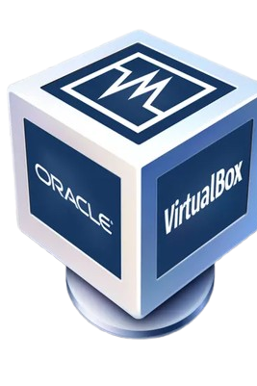
Installing OS using VirtualBox
What is VirtualBox?
A virtualization tool that allows running multiple OS on one machine.
Requirements:
• ISO file of OS
• Sufficient RAM and disk space

Slide 11
Steps in Installing an OS via VirtualBox
• Download and install VirtualBox
• Create a new virtual machine
• Allocate RAM and storage
• Attach the ISO file
• Start the VM and follow OS installation steps

Slide 12
Benefits of Using Virtual Machines
• Test multiple OS without needing extra hardware
• Safer environment for software testing
• Portable and easy to reset

Slide 13
Let’s get hands on open your pc.

